Slide 1
Code Snippet
Pradeep G Kumar

Slide 2
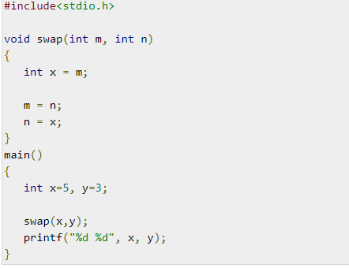
A - 3 5 B - 5 3 C - 5 5 D - Compile error

Slide 3
A - 3 5 B - 5 3 C - 5 5 D - Compile error

Slide 4
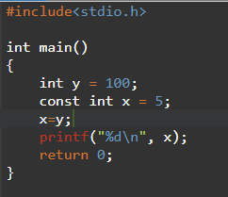
A - 100 B - 0 C - 5 D – Error : Assignment of read-only variable ‘x’
’

Slide 5
A - 100 B - 0 C - 5 D – Error : Assignment of read-only variable ‘x’
’

Slide 6
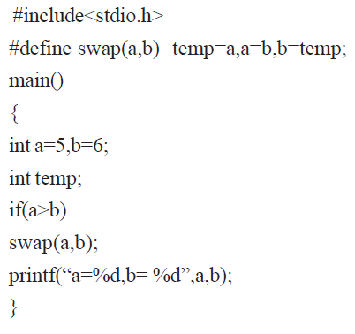
a) a=5 b=6 b) a=6 b=5 c) a=0 b=6 d) None

Slide 7
a) a=5 b=6 b) a=6 b=5 c) a=0 b=6 d) None

Slide 8
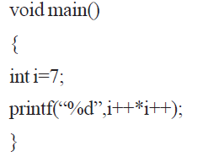
a) 7 b) 49 c) 56 d) 64

Slide 9
a) 7 b) 49 c) 56 d) 64

Slide 10
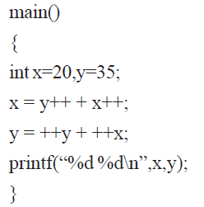
a) 57 94 b) 56 93 c) 55 92 d) 56 94

Slide 11
a) 57 94 b) 56 93 c) 55 92 d) 56 94

Slide 12
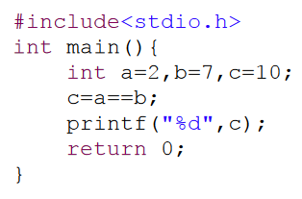
(A) 0 (B) 1 (C) 7 (D) 2 (E)Compilation error

Slide 13
(A) 0 (B) 1 (C) 7 (D) 2 (E)Compilation error

Slide 14
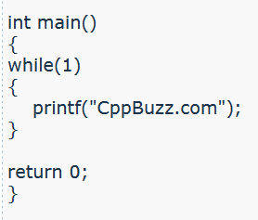
(A) 1 time (B) Compilation Error (C) Infinite times (D) Runtime Error

Slide 15
(A) 1 time (B) Compilation Error (C) Infinite times (D) Runtime Error

Slide 16
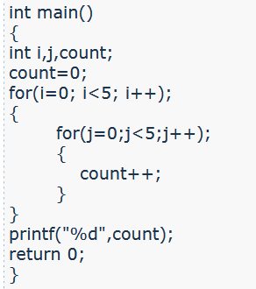
(A) 55 (B) 25 (C) 1 (D) 0

Slide 17
(A) 55 (B) 25 (C) 1 (D) 0

Slide 18
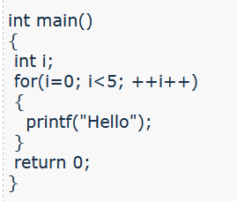
(A) Hello is printed 5 times (B) Compilation Error (C) Hello is printed 2 times (D) Hello is printed 3 times

Slide 19
(A) Hello is printed 5 times (B) Compilation Error (C) Hello is printed 2 times (D) Hello is printed 3 times

Slide 20
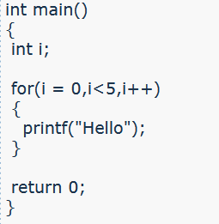
(A) Hello is printed 5 times (B) Compilation Error (C) Runtime Error (D) Hello is printed 4 times

Slide 21
(A) Hello is printed 5 times (B) Compilation Error (C) Runtime Error (D) Hello is printed 4 times

Slide 22
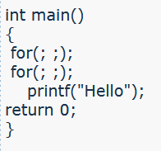
(A) Compilation Error (B) Runtime Error (C) Nothing is printed (D) Hello is printed infinite times

Slide 23
(A) Compilation Error (B) Runtime Error (C) Nothing is printed (D) Hello is printed infinite times

Slide 24
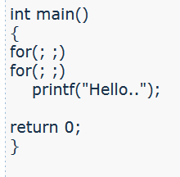
(A) Compilation Error (B) Runtime Error (C) Hello is printed one time (D) Hello is printed infinite times

Slide 25
(A) Compilation Error (B) Runtime Error (C) Hello is printed one time (D) Hello is printed infinite times

Slide 26
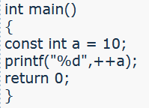
(A) 11 (B) 10 (C) Compilation Error (D) 0

Slide 27
(A) 11 (B) 10 (C) Compilation Error (D) 0

Slide 28
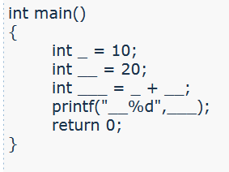
(A) Compilation Error (B) Runtime Error (C) __0 (D) __30

Slide 29
(A) Compilation Error (B) Runtime Error (C) __0 (D) __30

Slide 30
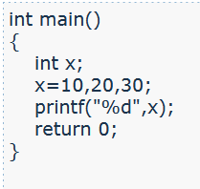
(A) 10 (B) 20 (C) 30 (D) Compilation Error

Slide 31
(A) 10 (B) 20 (C) 30 (D) Compilation Error

Slide 32
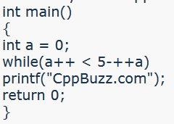
(A) 5 times (B) 4 times (C) 2 times (D) 1 time

Slide 33
(A) 5 times (B) 4 times (C) 2 times (D) 1 time

Slide 34
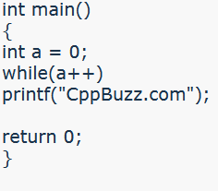
(A) 1 time (B) 0 time (C) Infinite times(Untill Stack is overflow) (D) 2 times

Slide 35
(A) 1 time (B) 0 time (C) Infinite times(Untill Stack is overflow) (D) 2 times

Slide 36
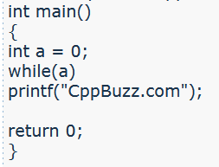
(A) 1 time (B) Compilation Error (C) 0 time (D) Infinite Times(Untill Stack is Overflow)

Slide 37
(A) 1 time (B) Compilation Error (C) 0 time (D) Infinite Times(Untill Stack is Overflow)

Slide 38
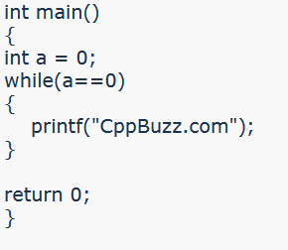
(A) 0 times (B) Infinite times (Untill Stack is overflow) (C) 1 time (D) Nothing is printed

Slide 39
(A) 0 times (B) Infinite times (Untill Stack is overflow) (C) 1 time (D) Nothing is printed

Slide 40
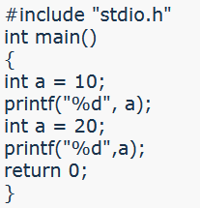
(A) 1020 (B) 1010 (C) 2020 (D) Error: Redeclartion of a

Slide 41
(A) 1020 (B) 1010 (C) 2020 (D) Error: Redeclartion of a

Slide 42
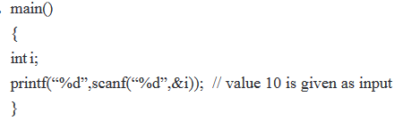
a) 1 b)0 c)10 d) Error

Slide 43
a) 1 b)0 c)10 d) Error

Slide 44
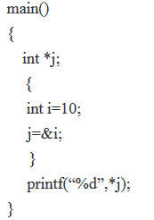
a) 10 b) 65432 c)&i d) Error

Slide 45
a) 10 b) 65432 c)&i d) Error

Slide 46
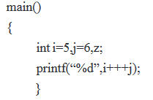
a) 11 b)12 c)Error d) 13

Slide 47
a) 11 b)12 c)Error d) 13

Slide 48
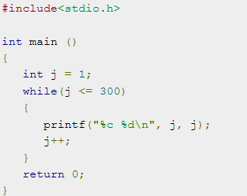
How many times loop will be executed?? a) 0 b) 300 c) Error d) Infinite

Slide 49
How many times loop will be executed?? a) 0 b) 300 c) Error d) Infinite

